Slide 1
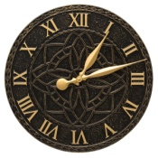
Gradient Clock Synchronization
max_{{v,w}ϵE}|L_{v}-L_{w}| << max_{v,wϵV}|L_{v}-L_{w}|

Slide 2
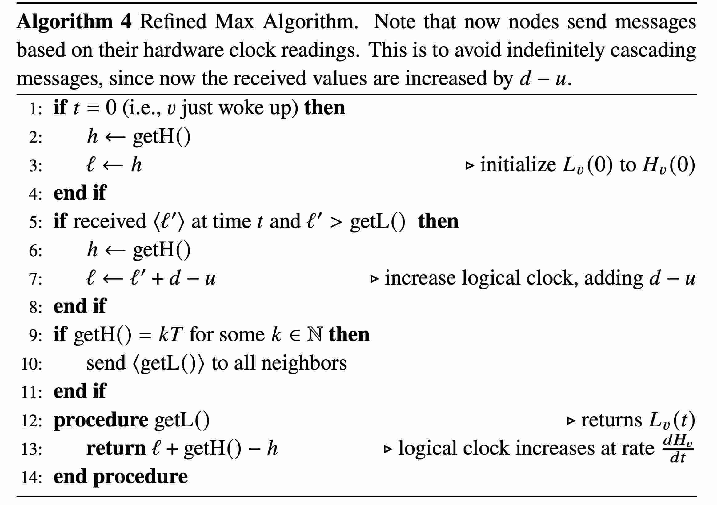
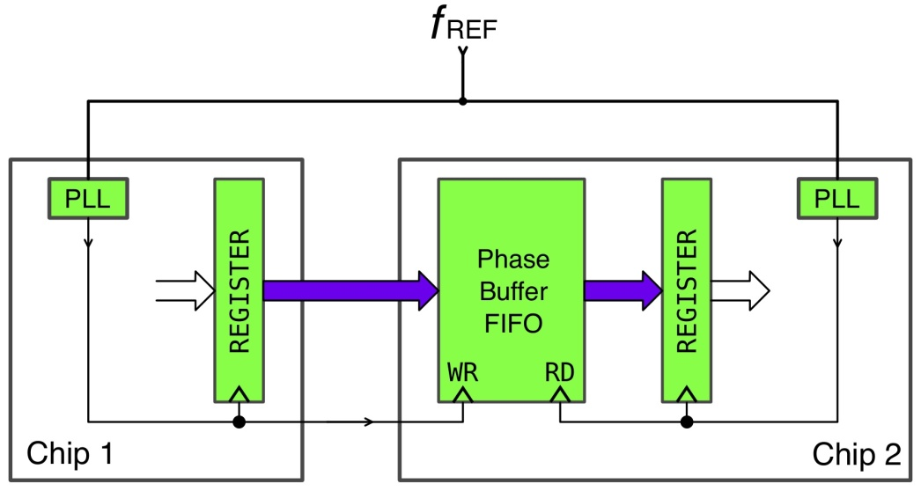
Previously...
VS

Slide 3
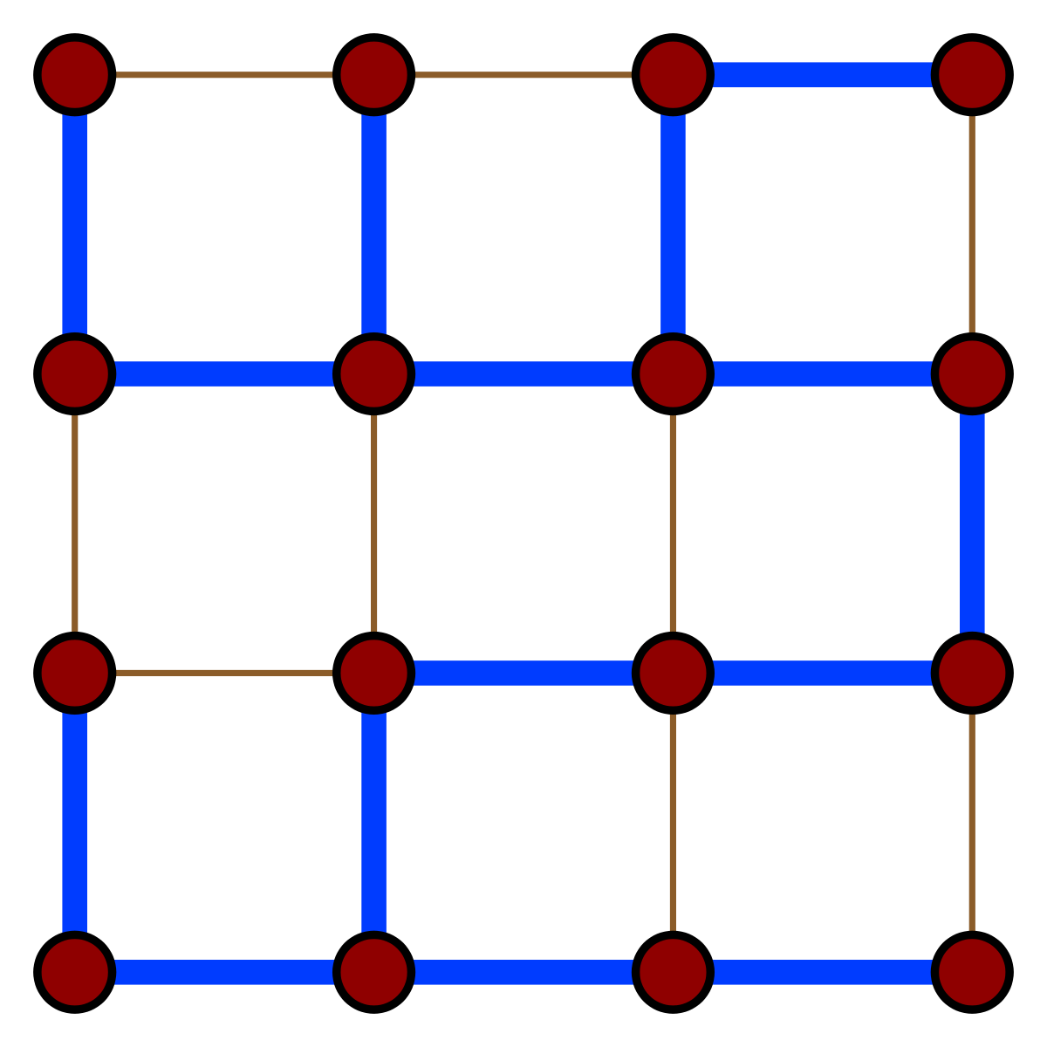
Clock Trees vs. Synchronization Algorithm
clock tree:
skew Θ(uD)
vs.
max algo:
skew Θ(uD)
Θ(D)

Slide 4
Same Difference?
...there‘s plenty of differences to list, but I‘m not sure whether they matter (enough)!

Slide 5
No! Wrong Question!
: global skew
= max_{{v,w}ϵE}|L_{v}-L_{w}|

Slide 6
New Task: Minimize Local Skew!
: global skew
= max_{v,wϵV}|L_{v}-L_{w}|
: local skew
= max_{{v,w}ϵE}|L_{v}-L_{w}|

Slide 7
Let‘s do this! Part 1: Halting Clocks
Idea:
- increase logical clock at hardware clock rate
- send “tick” every d time
- wait at L_{v} = kd until received tick k from all neighbors
breakout session:
understand algorithm and proof, answer questions

Slide 8
Important Check: Is this Enough?
Attention: clock might stop for Ω(uD) time!
disadvantages:
- response time to local/external events grows with D
- still cannot synchronize any action better than O(uD)
Important: this might be fine!
...but what if not?
Gradient Clock Synchronization:
Minimize local skew, but ensure dL/dt ≥ dH/dt

Slide 9
Can‘t do this! Part 1: Fast Clocks don‘t Help
If an algorithm uses (amortized) logical clock rate (1+μ)dH/dt, it has local skew Ω(μ u)

Slide 10
Can‘t do this! Part 1: Fast Clocks don‘t Help
If an algorithm uses (amortized) logical clock rate (1+μ)dH/dt, it has local skew Ω(μ u)
7
8
9
10
11
H_{v}
v
w
7
8
9
10
11
H_{w}

Slide 11
Can‘t do this! Part 1: Fast Clocks don‘t Help
If an algorithm uses (amortized) logical clock rate (1+μ)dH/dt, it has local skew Ω(μ u)
7
8
9
10
11
H_{v}
v
w
7
8
9
10
11
H_{w}
7
8
9
10
11
H_{v}
v
w
7
8
9
10
11
H_{w}

Slide 12
Can‘t do this! Part 1: Fast Clocks don‘t Help
If an algorithm uses (amortized) logical clock rate* (1+μ)dH/dt, it has local skew Ω(μ u)
*in certain executions
7
8
9
10
11
H_{v}
v
w
7
8
9
10
11
H_{w}
7
8
9
10
11
H_{v}
v
w
7
8
9
10
11
H_{w}

Slide 13
Upcoming...
We have seen:
- constant local skew is possible
...but the algorithm might stop clocks for Ω(uD) time
- clock rates of ω(1) cause local skew ω(u)
next sessions:
- dL/dt ≥ dH/dt also entails local skew ω(u)
- GCS algorithm matching the lower bound

