Slide 1
Hardware Implementation of the GCS Algorithm

Slide 2

GCS Algorithm - Intuition
≤ (2s-1)κ
slow condition:
fast condition:
≥ (2s-1)κ
≤ (2s-2)κ
≥ (2s-2)κ

Slide 3
Difference to Lecture
two sided error
default to slow
bounded skew (6κ)
discrete time

Slide 4
GCS Algorithm - Pseudo Code
≤ (2s-1)κ
≥ (2s-1)κ
≤ (2s-2)κ
≥ (2s-2)κ

Slide 5
GCS Algorithm - Modules
Identify three modules
  Adjustable Clock
  Time Measurement
  Controller

Slide 6
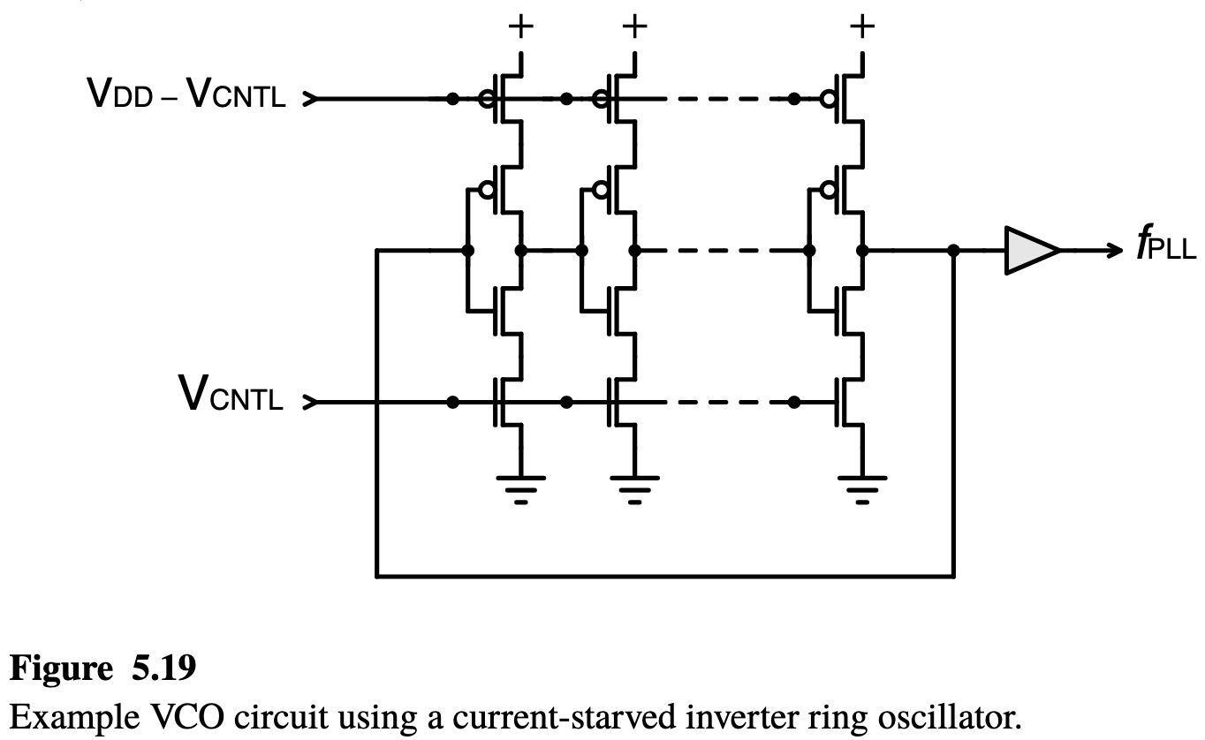
Adjustable Clock - VCO recap
Voltage Controlled Oscillator (VCO)
two speed modes
  slow (MODE <= low)
  fast (MODE <= high)
metastability safe
  If MODE <= [low, high]
  Then speed ∈ [slow, fast]

Slide 7
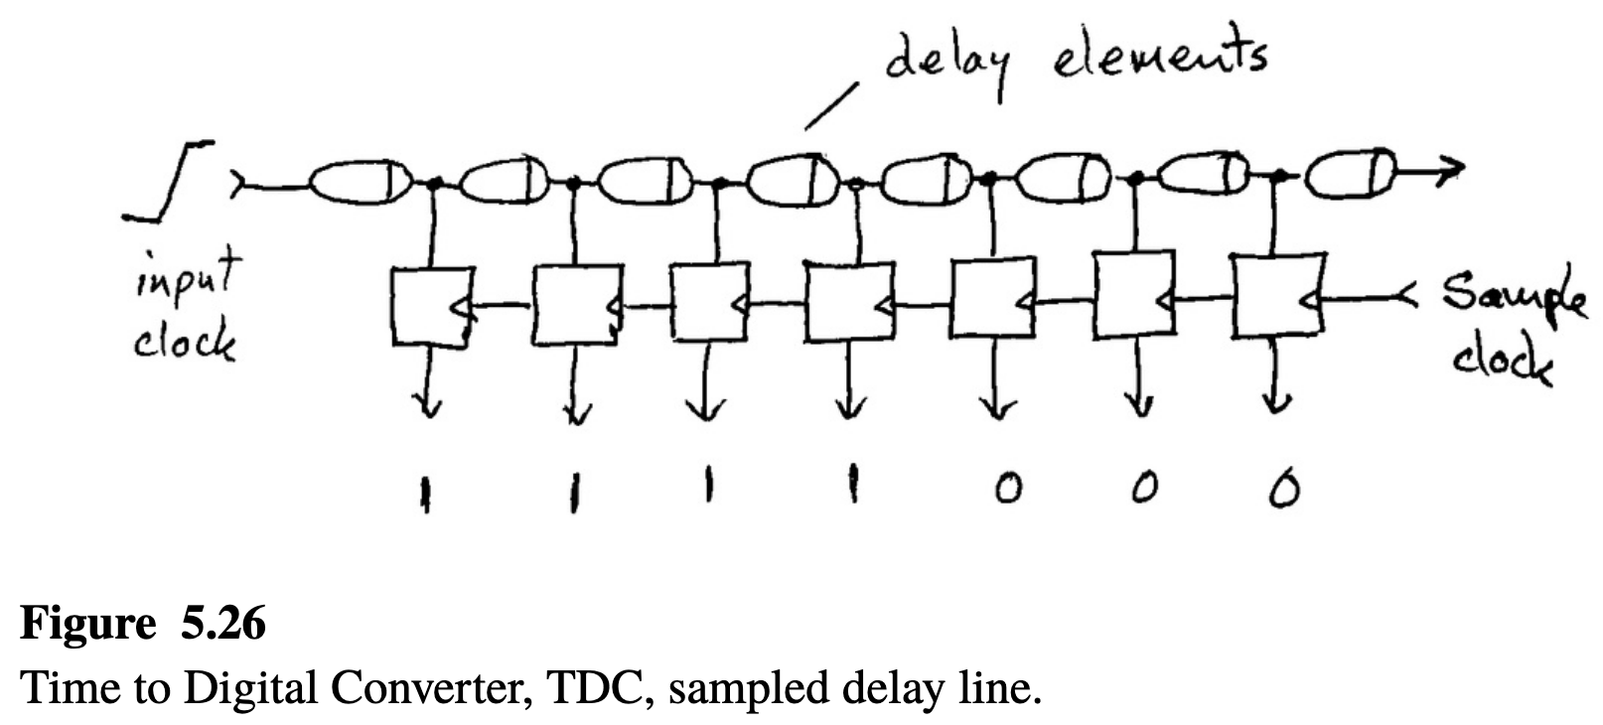
Time Measurement - TDC recap
Time to Digital Converter (TDC)
for each neighbor
inputs:
  local clock
  neighbor clock
delay element = 2κ
neighbor may be ahead or behind
one sided

Slide 8
Time Measurement - custom TDC
delay the neighbor clock
both are synchronized:
  meas^{i} = 111 000
neighbor clock is ahead:
  000 000, 100 000, 110 000
neighbor clock is behind:
  111 100, 111 110, 111 111

Slide 9
Time Measurement - encoding
6κ
000 000
neighbor ahead
  xxx 000
  meas_{[5,4,3]}
neighbor behind
  111 xxx
  meas_{[2,1,0]}
4κ
100 000
2κ
110 000
111 000
111 000
-2κ
111 100
-4κ
111 110
-6κ
111 111

Slide 10
Controller - recap boolean circuits
Input: measurement for each neighbor i
  meas^{i}_{[5,4,3,2,1,0]}
Output: VCO control (slow / fast)
  MODE
Functionality:

Slide 11
Controller - select maximum
neighbor ahead:
  meas_{[5,4,3]}
for each bit:
  AND over all measurements

Slide 12
Controller - select minimum
neighbor behind
  meas_{[2,1,0]}
for each bit:
  OR over all measurements

Slide 14
Controller - If |max| > |min|
output high
  if max is more ahead, than min is behind
max has more 0s, than min has 1s

Slide 15
Controller - If |max| > |min|
output high
  if max is more ahead, than min is behind
max has more 0s, than min has 1s
example: synchronized

Slide 16
Controller - If |max| > |min|
output high
  if max is more ahead, than min is behind
max has more 0s, than min has 1s
example:
  max = 2κ, min = 0κ

Slide 17
Controller - If |max| > |min|
output high
  if max is more ahead, than min is behind
max has more 0s, than min has 1s
example:
  max = 0κ, min = -4κ

Slide 18
What about Metastability?
Option 1:
use synchronizers
for each neighbor
  delay the measurement for 1-2 clock cycles
Option 2:
metastability safe design
  VCO can handle metastability
  build Controller accordingly

Slide 19
Plug things together

Slide 20
Simulation Demo
4 nodes
at 2 GHz
speed up μ = 10⁻⁴
drift ρ = 10⁻⁵
levels κ = 10 ps
error δ = 5 ps

